Slide 1

A Practical Application of the ISA/IEC 62443 Standard Series
IoT SCADA Hackers Australia December 2023

Slide 2
Agenda
/whois @beLarge
Overview of the ISA/IEC 62443 Standard Series
Using Part 2-1 to Build a Cyber Security Management System
Applying Part 3-2 and Part 3-3 to Projects
Further Resources

Slide 3


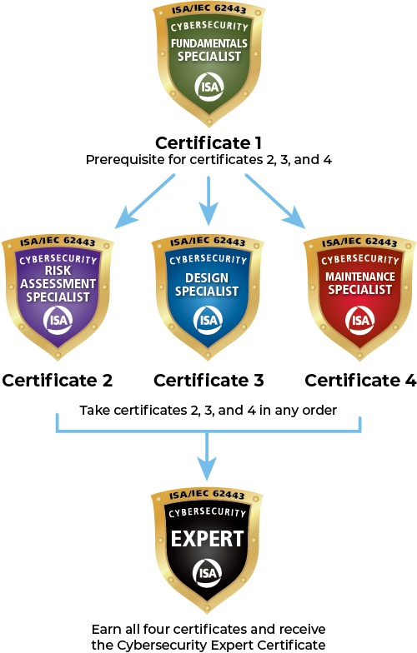
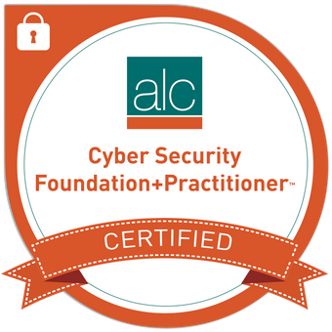

/whois @beLarge
Operational Technology (OT) Security Team Leader at Powerlink
Worked in IT and OT in Network & System Engineering and Cyber Security roles for 15 years
Chartered Engineer (CPEng) and Registered Professional Engineer of Queensland (RPEQ)
Proud member of Professional’s Australia (PA), incoming president of Qld Professional Engineers and a union delegate for PA at Powerlink
Vice Chair of the Queensland Branch of the Australian Information Security Association (AISA) and Chair of the AISA Security Architecture Special Interest Group (SecARCH SIG)
Bach Eng (Telecomms) QUT First Class Honours and Master Business (Applied Finance) with Distinction QUT
A cyber security architecture enthusiast, infrastructure tourist and “cyber hype guy”

Slide 4
Overview of the ISA/IEC 62443 Standards Series

Slide 5
Overview of ISA/IEC 62443
ISA/IEC 62443 is a Framework of Cyber Security Standards for Industrial Automation and Control Systems (IACS)
ISA 99 is the Working group and the standards were originally published with ANSI as ISA 99 but are now published in partnership with the IEC and are designated ISA/IEC 62443
You might see ISA 95 – Enterprise-Control System Integration – it is based on the Purdue Model but it is separate to ISA 62443
ISA 62443 is referenced by the NIST Cyber Security Framework but only 2 of the 14 publications referenced (Part 2-1 and Part 3-3 )

Slide 6
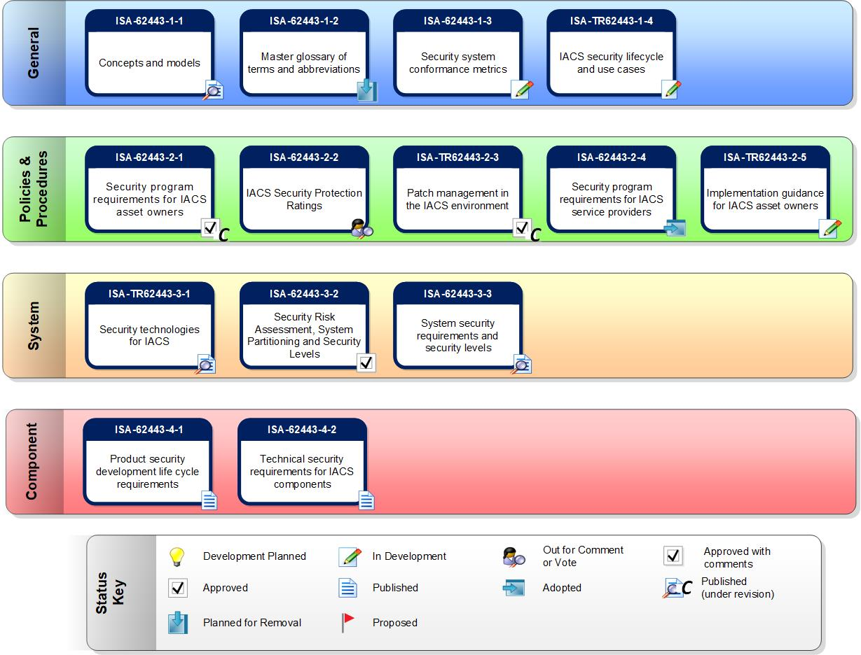
Standard Series Matrix

Slide 7
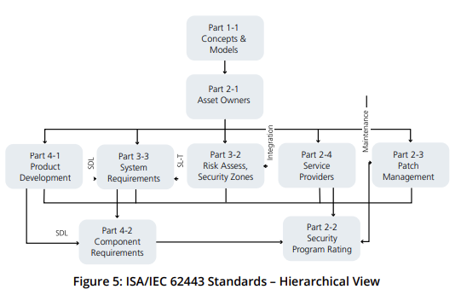
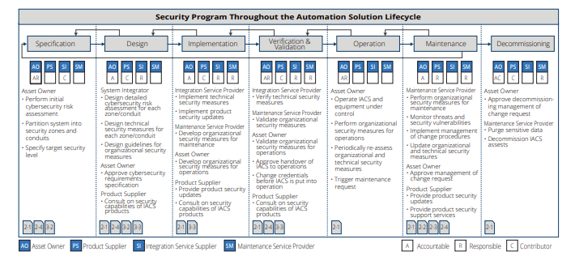
Hierarchy and Lifecyle View
Ref – ISAGCA Quick Start Guide & Roles and Responsibilities in the Security Lifecycle

Slide 8
Build a Cyber Security Management System
Using Part 2-1

Slide 9
Definition of a CSMS
Cyber Security Management System
Program designed by an organization to maintain the cyber security of the entire organization’s assets to an established level of confidentiality, integrity and availability, whether they are on the business side or the industrial automation and control systems side of the organization
Ref – 62443 Part 2-1

Slide 10
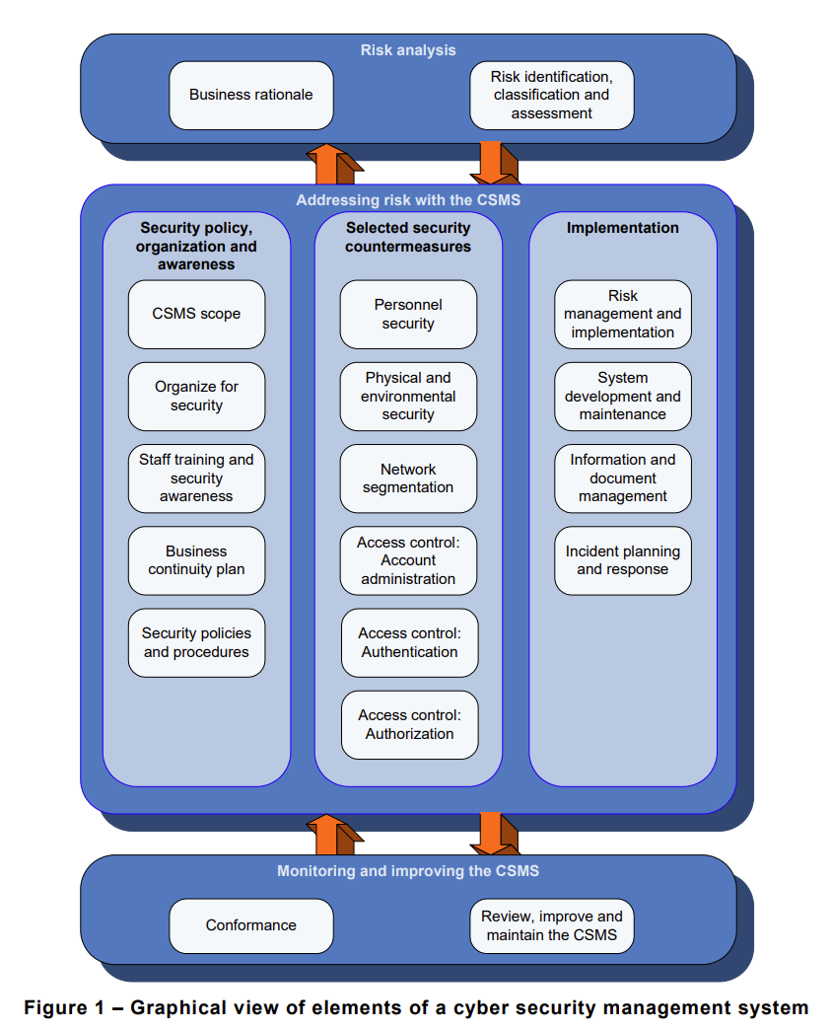
Overview of CSMS Elements
Ref – Part 2-1
Notes:
Category > (Element or Element Group)

Slide 11
Process to Develop CSMS (Annex B)
Initiate CSMS Program
High-Level Risk Assessment
Establish Policy, Organisation and Awareness
Maintain the CSMS
Detailed Risk Assessment
Select and Implement Countermeasures
Ref – 62443 Part 2-1

Slide 12
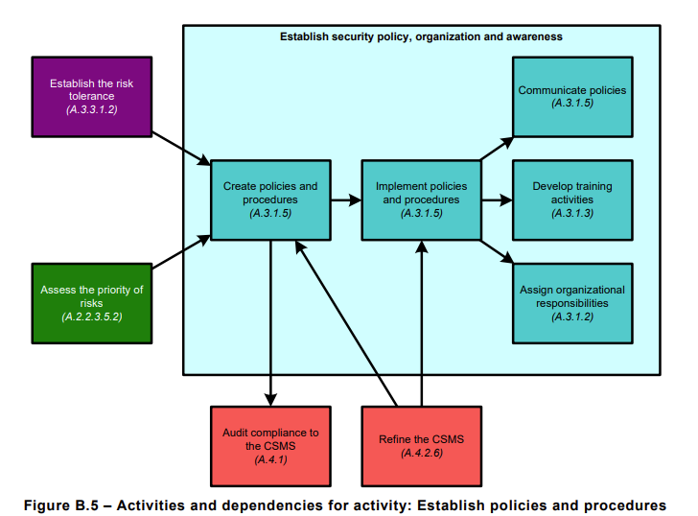
Establish Policies and Procedures
Ref – 62443 Part 2-1

Slide 13
Application for a Project
Using Part 3-2 and Part 3-3

Slide 14
Zone and Conduit Definitions
Zone
grouping of logical or physical assets based upon risk or other criteria, such as criticality of assets, operational function, physical or logical location, required access (For example, least privilege principles) or responsible organisation
Conduit
Logical grouping of communication channels that share a common security requirements connecting two or more zones
Ref – 62443 Part 3-2

Slide 15
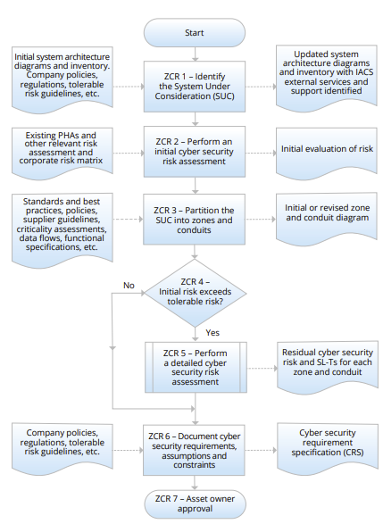
Overview of Part 3-2 - HLRA
ISAGCA Leveraging ISA 62443-3-2 For IACS Risk Assessment and Risk Related Strategies

Slide 16
Partitioning the SuC
ZCR 3.1 Establish Zones and Conduits
ZCR 3.2 Separate business and IACS assets
ZCR 3.3 Separate Safety related assets
ZCR 3.4 Separate temporarily connected devices
ZCR 3.5 Separate wireless devices
ZCR 3.6 Separate devices connected via external networks
Block
Diagram
TBD
Ref – 62443 Part 3-2 and IC33 Training Materials

Slide 17
Security Level Definitions
Target (SL-T) are the desired level of security for a particular Automation Solution. They are determined as the result of the Risk Assessment process (Part 3-2) and are documented in the Cybersecurity Requirements Specification. SL-T are used to select products and additional countermeasures during the Integration phase of the IACS lifecycle
Capability (SL-C) are the security levels that systems or Components can provide when properly configured. These levels state that a particular system or Component is capable of meeting the SL-T natively without additional compensating countermeasures.
Achieved (SL-A) are the actual levels of security for a particular Automation Solution. These are measured after the Automation Solution is commissioned and in operation.
SL-1 Prevent the unauthorized disclosure of information via eavesdropping or casual exposure
SL-2 Prevent the unauthorized disclosure of information to an entity actively searching for it using simple means with low resources, generic skills, and low motivation
SL-3 Prevent the unauthorized disclosure of information to an entity actively searching for it using sophisticated means with moderate resources, IACS-specific skills, and moderate motivation
SL-4 Prevent the unauthorized disclosure of information to an entity actively searching for it using sophisticated means with extended resources, IACS-specific skills, and high motivation
Ref – ISAGCA Quick Start Guide

Slide 18
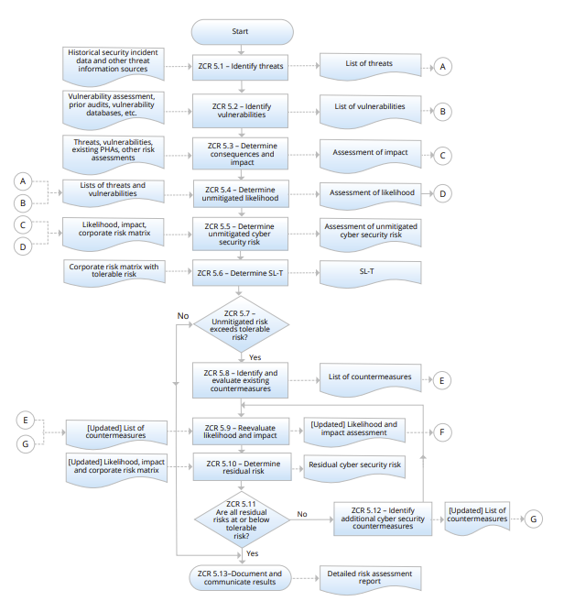
Overview of Part 3-2 – Detailed Risk Assessment
Ref – ISAGCA Quick Start Guide

Slide 19
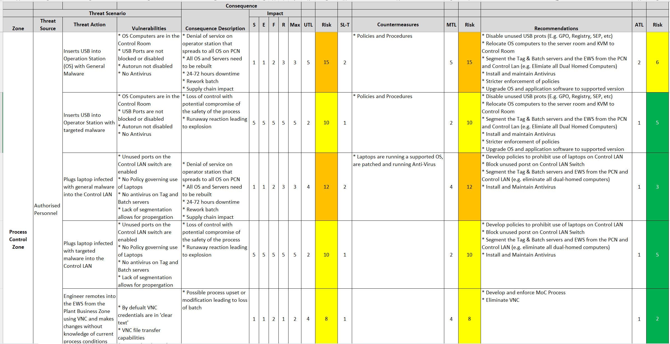
Example 62443 Risk Workbook
Where:
UTL – Unmitigated Threat Likelihood
SL-T Security Level Target
MTL – Mitigated Threat Likelihood
ATL – Adjusted Threat Likelihood
Ref –IC33 Training Materials

Slide 20
Cyber Security Requirements Specification (CSRS)
ZCR 6.2 SuC Description
ZCR 6.3 Zone and Conduit drawings
ZCR 6.4 Zone and Conduit Characteristics
ZCR 6.5 Operating environment assumptions
ZCR 6.6 Threat environment
ZCR 6.7 Organisational security policies
ZCR 6.8 Tolerable Risk
ZCR 6.9 Regulatory requirements
Ref – 62443 Part 3-2

Slide 21
Part 3-3 FR Counts
FR 1 – Identification and Authentication Control (IAC)
FR 2 – Use Control (UC)
FR 3 – System Integrity (SI)
FR 4 – Data Confidentiality (DC)
FR 5 – Restricted Data Flow (RDF)
FR 6 – Timely Response to Events (TRE)
FR 7 – Resource Availability (RA)
Foundational Requirement | Count SL-1 | Count SL-2 | Count SL-3 | Count SL-4
IAC | 10 | 6 | 6 | 2
UC | 8 | 4 | 9 | 3
SI | 6 | 4 | 6 | 3
DC | 2 | 2 | 1 | 1
RDF | 4 | 2 | 4 | 1
TRE | 1 | 1 | 1 | -
RA | 7 | 3 | 3 | -
Ref – 62443 Part 3-3

Slide 22
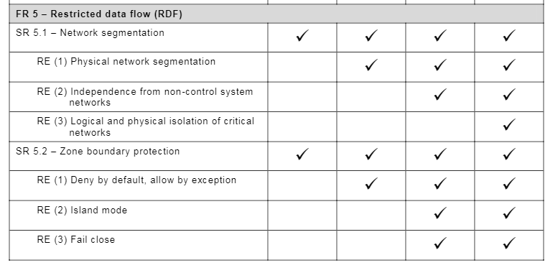
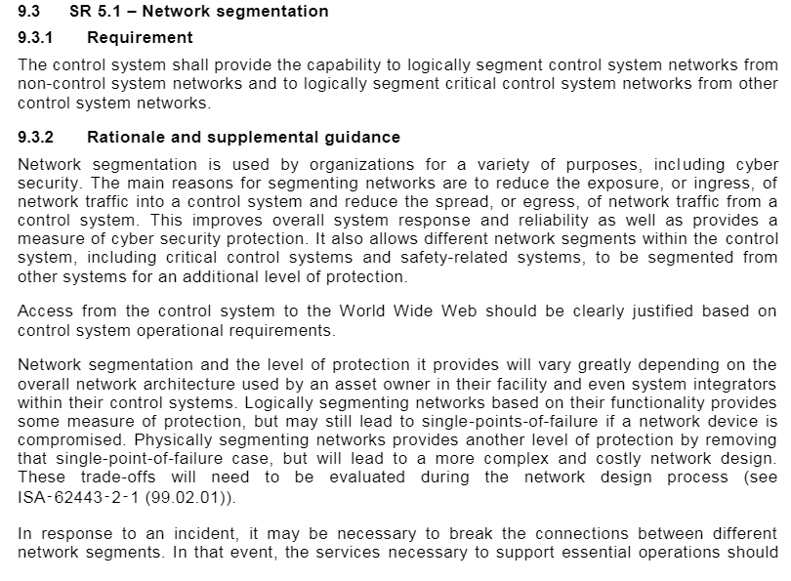
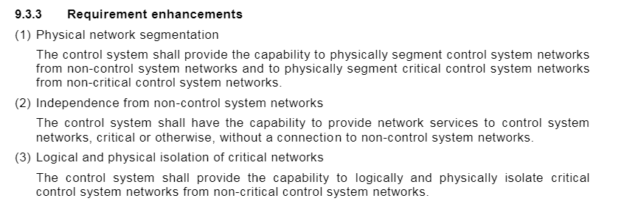
Example 3-3

Slide 23
Further Resources

Slide 24
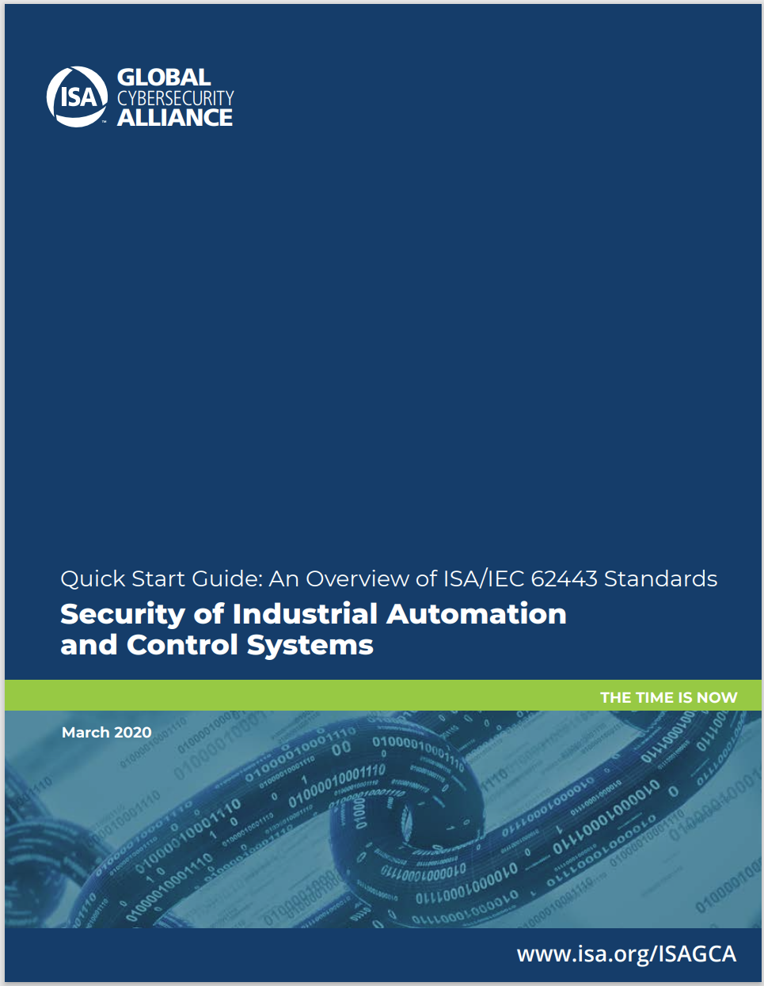

https://www.isa.org/membership
https://gca.isa.org/hubfs/ISAGCA%20Quick%20Start%20Guide%20FINAL.pdf

Slide 25
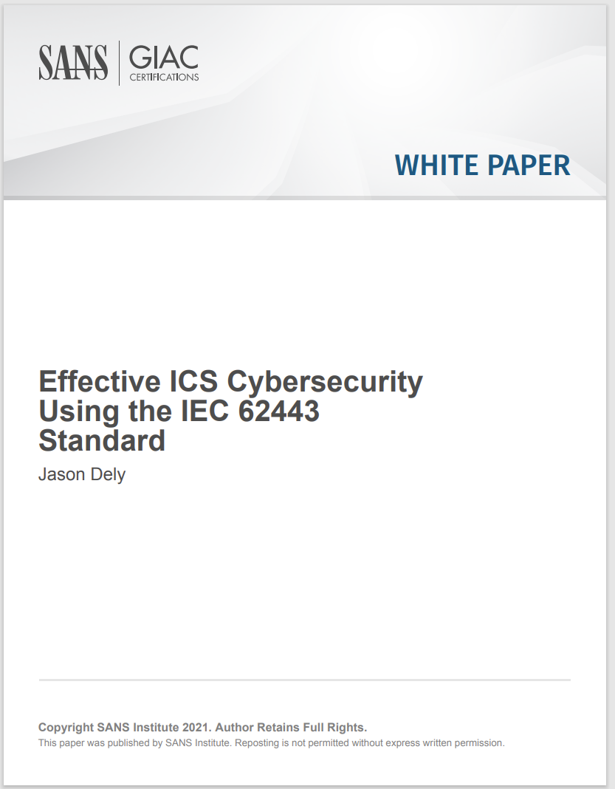
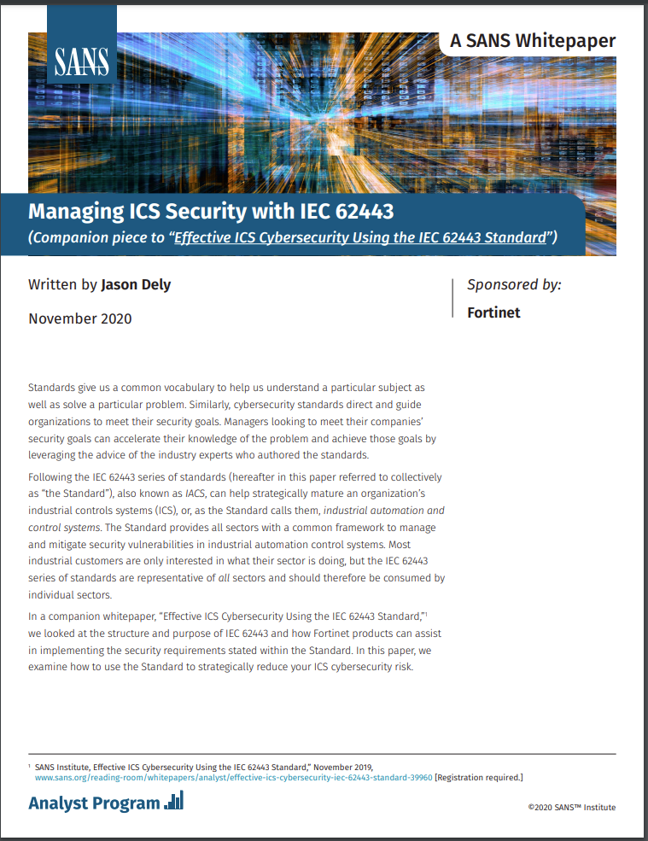
https://www.sans.org/white-papers/39990/
https://www.sans.org/white-papers/39990/

Slide 26
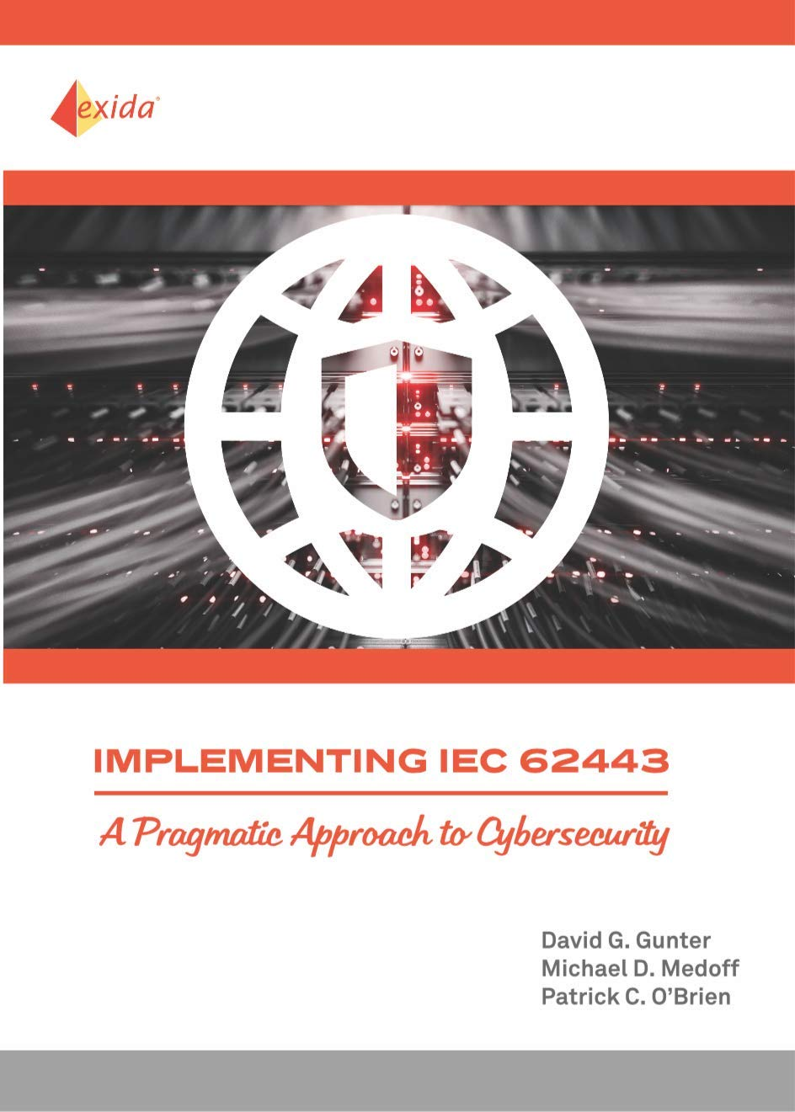
https://www.amazon.com.au/Implementing-IEC-62443-Pragmatic-Cybersecurity/dp/1934977179
https://www.isa.org/certification/certificate-programs/isa-iec-62443-cybersecurity-certificate-program

